Slide 1

Introduction
Kingdom of Saudi Arabia
Shaqra University
College of Computer Science
CS217

Slide 2
CS240
Course URL:
http://csc217.wikispaces.com/home
Text Book:
C++ How to Program, DETITEL & DEITEL, eighth Edition

Slide 3
Course Syllabus
Topics
Introduction
Data types, variables, values, assignment
Sequence, iteration, branching statements
Functions
Arrays
Pointers and Strings
Recursion

Slide 4
Course Objectives
Learn data types, control structures, functions, and arrays.
Learn algorithms and problem-solving.
Learn analysis of problems using structured programming.
Learn program correctness and verification.
Learn the mechanics of running, testing, and debugging

Slide 5
Grading
2 Midterms : 20%
Participation: 3% (Bonus)
Lab work : 20% “we will discuss it in more detail in the lab”
Final exam: 40%
Final lab: 15%
quizzes: 5 Marks

Slide 6
Outline
Introduction
What is a Computer?
Machine Languages, Assembly Languages, and High-Level Languages
C++ Standard Library
Structured Programming
Basics of a Typical C++ Environment
Introduction to C++ Programming
A Simple Program: Printing a Line of Text
Another Simple Program: Adding Two Integers
Memory Concepts

Slide 7
Introduction
Software
  Instructions to command computer to perform actions and make decisions
Hardware
  Computer hardware is any physical device (e.g. the computer monitor), something that you are able to touch
Structured programming
Object-oriented programming

Slide 8
What is a Computer?
Computer
  Device capable of performing computations and making logical decisions
Computer programs
  Sets of instructions that control computer’s processing of data
Hardware
  Various devices comprising computer
    Keyboard, screen, mouse, disks, memory, CD-ROM, processing units, …
Software
  Programs that run on computer

Slide 9
Machine Languages, Assembly Languages, and High-level Languages
Three types of computer languages
  Machine language
    Only language computer directly understands
    “Natural language” of computer
    Defined by hardware design
      Machine-dependent
    Generally consist of strings of numbers
      Ultimately 0s and 1s
    Instruct computers to perform elementary operations
      One at a time
    Cumbersome for humans
    Example:
      +1300042774
      +1400593419
      +1200274027

Slide 10
Machine Languages, Assembly Languages, and High-level Languages
Three types of computer languages
  Assembly language
    English-like abbreviations representing elementary computer operations
    Clearer to humans
    Incomprehensible to computers
      Translator programs (assemblers)
        Convert to machine language
    Example:
      LOAD BASEPAY
      ADD OVERPAY
      STORE GROSSPAY

Slide 11
Machine Languages, Assembly Languages, and High-level Languages
Three types of computer languages
  High-level languages
    Similar to everyday English, use common mathematical notations
    Single statements accomplish substantial tasks
      Assembly language requires many instructions to accomplish simple tasks
    Translator programs (compilers)
      Convert to machine language
    Interpreter programs
      Directly execute high-level language programs
    Example:
      grossPay = basePay + overTimePay

Slide 12
C++ Standard Library
C++ programs
  Built from pieces called classes and functions
C++ standard library
  Rich collections of existing classes and functions
    Common math calculations e.g. sqrt,sin,cos
    Input/output
    Date/Time
“Building block approach” to creating programs
  “Software reuse”

Slide 13
Basics of a Typical C++ Environment
C++ systems
  Program-development environment
  Language
  C++ Standard Library

Slide 14
Basics of a Typical C++ Environment
Editor
Program is created in
the editor and stored
on disk.
Disk
Phases of C++ Programs:
  Edit
  Preprocess
  Compile
  Link
  Load
  Execute
Preprocessor
Disk
Preprocessor program
processes the code.
Compiler creates
object code and stores
it on disk.
Compiler
Disk
Linker links the object
code with the libraries,
creates a.out and
stores it on disk
Linker
Disk
Primary
Memory
Loader
Loader puts program
in memory.
Disk
.
.
.
.
.
.
Primary
Memory
CPU
CPU takes each
instruction and
executes it, possibly
storing new data
values as the program
executes.
.
.
.
.
.
.

Slide 15
Basics of a Typical C++ Environment
  Edit: Programmer types a C++ program.
  Preprocess: e.g. include other text files to be compiled.
  Compile: translate the C++ program into machine language code.
  Link: links the code with the code for the missing functions.
  Load: load the executable code on memory.
  Execute: CPU executes the program one instruction at time.

Slide 16
1.1 First Program in C++: Printing a Line of Text
Simple program that prints a line of text (Fig. 2.1).
Welcome to C++!
Fig. 2.1

Slide 17
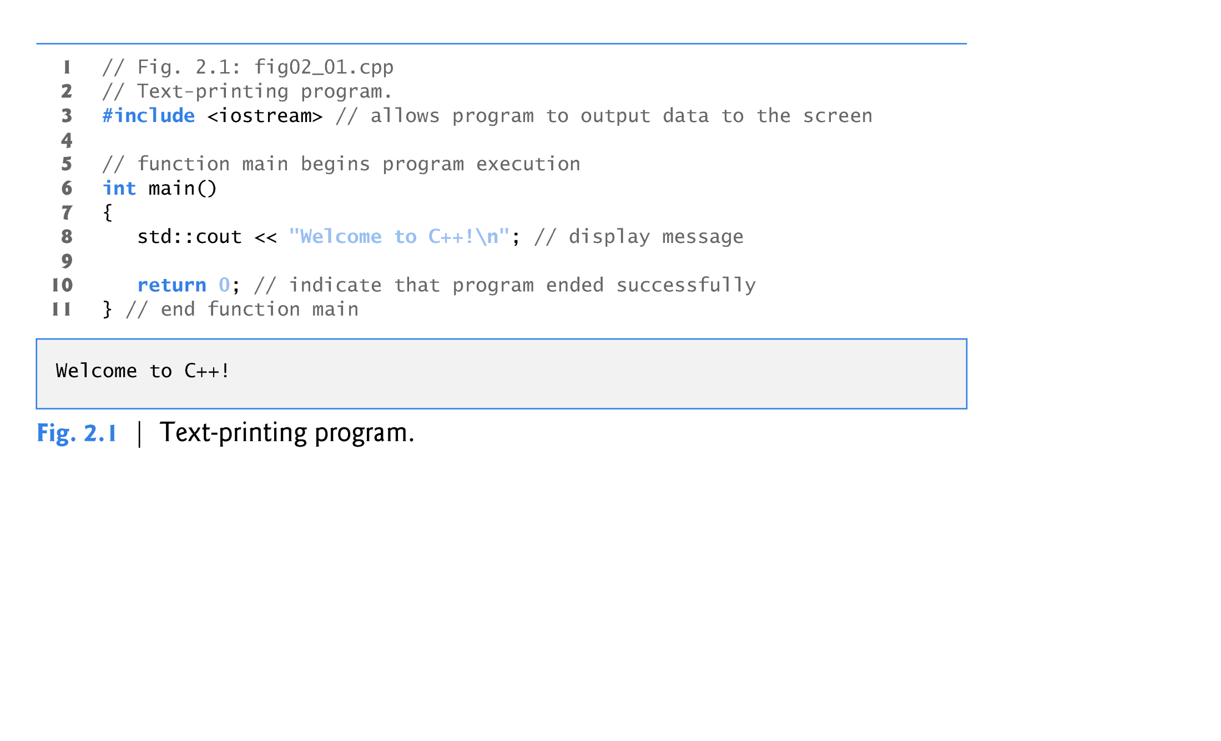

Slide 18
1.2 First Program in C++: Printing a Line of Text (cont.)
// indicates that the remainder of each line is a comment.
  You insert comments to document your programs and to help other people read and understand them.
  Comments are ignored by the C++ compiler and do not cause any machine-language object code to be generated.
A comment beginning with // is called a single-line comment because it terminates at the end of the current line.
You also may use C’s style in which a comment—possibly containing many lines—begins with /* and ends with */.

Slide 19
1.2 First Program in C++: Printing a Line of Text (cont.)
A preprocessor directive is a message to the C++ preprocessor.
Lines that begin with # are processed by the preprocessor before the program is compiled.
#include <iostream> notifies the preprocessor to include in the program the contents of the input/output stream header file <iostream>.
  Must be included for any program that outputs data to the screen or inputs data from the keyboard using C++-style stream input/output.

Slide 20
Basics of a Typical C++ Environment
Input/output
  cin
    Standard input stream
    Normally keyboard
  cout
    Standard output stream
    Normally computer screen
  cerr
    Standard error stream
    Display error messages

Slide 21
1.2 First Program in C++: Printing a Line of Text (cont.)
main is a part of every C++ program.
The parentheses after main indicate that main is a program building block called a function.
The keyword int to the left of main indicates that main “returns” an integer (whole number) value.
  A keyword is a word in code that is reserved by C++ for a specific use.
  For now, simply include the keyword int to the left of main in each of your programs.
A statement normally ends with a semicolon
  Preprocessor directives (like #include) do not end with a semicolon

Slide 22
Introduction to C++ Programming
C++ language
  Facilitates structured and disciplined approach to computer program design
Following several examples
  Illustrate many important features of C++
  Each analyzed one statement at a time

Slide 23
1
2 // A first program in C++.
3 #include <iostream>
4
5 // function main begins program execution
6 int main()
7 {
8 std::cout << "Welcome to C++!\n";
9
10 return 0; // indicate that program ended successfully
11
12 } // end function main
23
Function main returns an integer value.
Left brace { begins function body.
Preprocessor directive to include input/output stream header file <iostream>.
Function main appears exactly once in every C++ program..
Statements end with a semicolon ;.
Corresponding right brace } ends function body.
Stream insertion operator.
Name cout belongs to namespace std.
Keyword return is one of several means to exit function; value 0 indicates program terminated successfully.
Welcome to C++!

Slide 24
A Simple Program:
Printing a Line of Text
Standard output stream object
  std::cout
  “Connected” to screen
  <<
    Stream insertion operator
    Value to right (right operand) inserted into output stream
Namespace
  std:: specifies using name that belongs to “namespace” std
  std:: removed through use of using statements

Slide 25
1.2 First Program in C++: Printing a Line of Text (cont.)
The characters \n are not printed on the screen.
The backslash (\) is called an escape character.
  It indicates that a “special” character is to be output.
The escape sequence \n means newline.
  Causes the cursor to move to the beginning of the next line on the screen.
When the return statement is used at the end of main the value 0 indicates that the program has terminated successfully.
According to the C++ standard, if program execution reaches the end of main without encountering a return statement, it’s assumed that the program terminated successfully—exactly as when the last statement in main is a return statement with the value 0.

Slide 26
A Simple Program:
Printing a Line of Text

Slide 27
1.3 Modifying Our First C++ Program
Welcome to C++! can be printed several ways.

Slide 28
1
2 // Printing a line with multiple statements.
3 #include <iostream>
4
5 // function main begins program execution
6 int main()
7 {
8 std::cout << "Welcome ";
9 std::cout << "to C++!\n";
10
11 return 0; // indicate that program ended successfully
12
13 } // end function main
28
Multiple stream insertion statements produce one line of output.
Welcome to C++!

Slide 29
29
1
2 // Printing multiple lines with a single statement
3 #include <iostream>
4
5 // function main begins program execution
6 int main()
7 {
8 std::cout << "Welcome\nto\n\nC++!\n";
9
10 return 0; // indicate that program ended successfully
11
12 } // end function main
Using newline characters to print on multiple lines.
Welcome
to
C++!

Slide 30
Another Simple Program:
Adding Two Integers
Variables
  Location in memory where value can be stored
  Common data types
    int - integer numbers
    char - characters
    double - floating point numbers
Data type double is for specifying real numbers, and data type char for specifying character data.
Real numbers are numbers with decimal points, such as 3.4, 0.0 and –11.19.
A char variable may hold only a single lowercase letter, a single uppercase letter, a single digit or a single special character (e.g., $ or *).

Slide 31
1.4 Another C++ Program: Adding Integers (cont.)
  Declare variables with name and data type before use
    int integer1;
    int integer2;
    int sum;
  Can declare several variables of same type in one declaration
    Comma-separated list
    int integer1, integer2, sum;

Slide 32
Another Simple Program:
Adding Two Integers
Variables
  Variable names
A variable name is any valid identifier that is not a keyword.
      Series of characters (letters, digits, underscores)
      Does not begin with a digit.
      Case sensitive uppercase and lowercase letters are different, so a1 and A1 are different identifiers.

Slide 33
Another Simple Program:
Adding Two Integers
Input stream object
  >> (stream extraction operator)
    Used with std::cin
    Waits for user to input value, then press Enter (Return) key
    Stores value in variable to right of operator
      Converts value to variable data type
= (assignment operator)
  Assigns value to variable
  Binary operator (two operands)
  Example:
      sum = variable1 + variable2;

Slide 34
1.4 Another C++ Program: Adding Integers (cont.)
std::endl is a so-called stream manipulator.
The name endl is an abbreviation for “end line” and belongs to namespace std.
The std::endl stream manipulator outputs a newline.

Slide 35
1
2 // Addition program.
3 #include <iostream>
4
5 // function main begins program execution
6 int main()
7 {
8 int integer1; // first number to be input by user
9 int integer2; // second number to be input by user
10 int sum; // variable in which sum will be stored
11
12 std::cout << "Enter first integer\n"; // prompt
13 std::cin >> integer1; // read an integer
14
15 std::cout << "Enter second integer\n"; // prompt
16 std::cin >> integer2; // read an integer
17
18 sum = integer1 + integer2; // assign result to sum
19
20 std::cout << "Sum is " << sum << std::endl; // print sum
21
22 return 0; // indicate that program ended successfully
23
24 } // end function main
35
Declare integer variables.
Use stream extraction operator with standard input stream to obtain user input.
Calculations can be performed in output statements: alternative for lines 18 and 20:
std::cout << "Sum is " << integer1 + integer2 << std::endl;
Stream manipulator std::endl outputs a newline, then “flushes output buffer.”
Concatenating, chaining or cascading stream insertion operations.
Enter first integer
45
Enter second integer
72
Sum is 117

Slide 36
Memory Concepts
Variable names
  Correspond to actual locations in computer's memory
  Every variable has name, type, size and value
  When new value placed into variable, overwrites previous value
  The process of reading variables from memory is called nondestructive
  Placing new value into variable (memory location), overwrites old value- called destructive.

Slide 37
Memory Concepts
std::cin >> integer1;
  Assume user entered 45
std::cin >> integer2;
  Assume user entered 72
sum = integer1 + integer2;
integer1
45
integer1
45
integer2
72
integer1
45
integer2
72
sum
117

Slide 38
Questions

