Slide 1
Control Statements

Slide 2
Objectives
In this chapter you will learn:
  Essentials of counter-controlled repetition.
  Use for, while and do … while to execute statements in program repeatedly.
  Use nested control statements in your program.

Slide 3
Recall: Control structures in C++
C++ Control Structure
Sequence structure
While, do…while, for
Selection Structure
Repetition structure
If, if… else, switch

Slide 4
Essentials of counter-controlled repetition requires:
The name of a control variable (loop counter)
The initial value of the control variable.
The loop-continuation condition that test for the final value of the control variable.
The increment (or decrement) by which the control variable is modified each time through the loop

Slide 5
While Repetition Structure
In general any repetition structure
  Action repeated while some condition remains true
  Psuedocode
  while loop repeated until condition becomes false
Example
      int product = 2;
      while ( product <= 1000 )
      product = 2 * product;

Slide 6
Activity Diagram for while statement
true
product <= 1000
product = 2 * product
false

Slide 7

While Repetition Structure
Syntax:
If the controlling expression is true, the loop body is then executed before the controlling expression is evaluated once more.
If the controlling expression is false, i.e. expression evaluates to false, the program goes on to execute the statement following the while loop.

Slide 8
While Repetition Structure
If the body of the counter-controlled repetition contains more than one statement, you should surround its body by braces { }.

Slide 9
Example
Write a c++ programme print numbers from 1 to 10?

Slide 10
Example
1
2 // Counter-controlled repetition.
3 #include <iostream>
4
5 using std::cout;
6 using std::endl;
7
8 // function main begins program execution
9 int main()
10 {
11 int counter = 1; // initialization
12
13 while ( counter <= 10 ) { // repetition condition
14 cout << counter << endl; // display counter
15 ++counter; // increment
16
17 } // end while
18
19 return 0; // indicate successful termination
20
21 } // end function main

Slide 11
Essentials of counter-controlled repetition requires:
The declaration
      int counter = 1;
  Names counter
  Declares counter to be an integer
Sets counter to an initial value of 1
The loop continuation condition determines either the value of the control variable is less than or equal to 10.
The loop counter is incremented by 1 each time the loop’s body is performed.

Slide 12
while example
Write a pesudocode to find the average of the students grade for five subjects in the class.
Pseudocode:
    Set total to zero
    Set grade counter to one
    While grade counter is less than or equal to five
    Input the next grade
    Add the grade into the total
    Add one to the grade counter
    Set the class average to the total divided by ten
    Print the class average

Slide 13
while example
#include <iostream>
using namespace std;
int main ()
{
int total=0; //sum of the grade entered by user
int gradecounter=1; //number of the grade to be entered next
int grade; //grade value entered by user
while ( gradecounter <= 5 ) // loop 5 times
{
cout << "Enter grade" << endl;
cin>>grade; //input next grade
total=total+grade; //add grade to total
gradecounter++; // increment counter by 1
}
cout<<total/5; //display the average of grades
}

Slide 14
for Repetition Structure
General format when using for loops
  for ( initialization; LoopContinuationTest; increment )
  statement
Example
  for( int counter = 1; counter <= 10; counter++ )
    cout << counter << endl;
  Prints integers from one to ten
No semicolon after last statement

Slide 15
for Repetition Structure
As we said in while, If you need to repeat more than one statement in a program loop, you must place the statements in a block marked by braces
{ }.

Slide 16
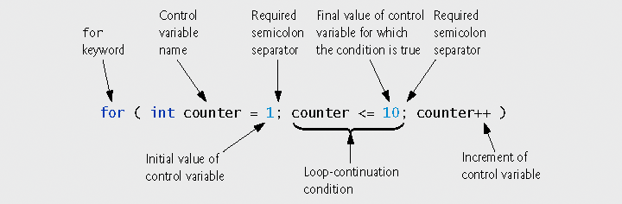
for Repetition Structure

Slide 17
for Repetition example
1
2 // Counter-controlled repetition with the for structure.
3 #include <iostream>
4
5 using namespace std;
6
7
8 // function main begins program execution
9 int main()
10 {
11 // Initialization, repetition condition and incrementing
12 // are all included in the for structure header.
13
14 for ( int counter = 1; counter <= 10; counter++ )
15 cout << counter << endl;
16
17 return 0; // indicate successful termination
18
19 } // end function main

Slide 18
for Repetition Structure
for loops can usually be rewritten as while loops
    initialization;
    while (loopContinuationCondition)
    {
    statement
    increment;
    }
Initialization and increment
  For multiple variables, use comma-separated lists
    for (int i = 0, j = 0; j + i <= 10; j++,i++)
    cout << j + i << endl;

Slide 19
Optional expressions in the for statement header
All the three expressions in the for statement header are optional .
  The two semicolon are required.
Omitting the loopContinuationCondition:
  C++ assumes that the condition is true.
Omitting the initialization expression:
  The counter variable must be initialized earlier in the program.
Omitting increment expression:
  The increment is calculated by statement in the body.

Slide 20
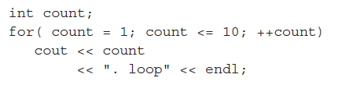



Examples:

Slide 21
The counter variable
If the initialization expression declares the control variable , the control variable can be used only in the body of the for statements.
This is what we called variable scope.

Slide 22
Example:
1
2 // Summation with for.
3 #include <iostream>
4
5 using namespace std;
6
7
8 // function main begins program execution
9 int main()
10 {
11 int sum = 0; // initialize sum
12
13 // sum even integers from 2 through 100
14 for ( int number = 2; number <= 100; number += 2 )
15 sum += number; // add number to sum
16
17 cout << "Sum is " << sum << endl; // output sum
18 return 0; // successful termination
19
20 } // end function main
Sum is 2550

Slide 23
Tracing the above example:
sum | sum += number | number
2 | 0+=2 | 2
6 | 2+=4 | 4
12 | 6+=6 | 6
20 | 12+=8 | 8
30 | 20+=10 | 10
….. ….. ….. | ….. ….. ….. | ….. ….. …..
2550 | 2450+=100 | 100

Slide 24
Examples Using the for Statement
Vary control variable from 1 to 5 in increments of 1
  for ( int i = 1; i <= 5; i++ )
Vary control variable from 5 to 1 in decrements of 1
  for ( int i = 5; i >= 1; i-- )
Vary control variable from 7 to 77 in steps of 7
  for ( int i = 7; i <= 77; i += 7 )
Vary control variable from 20 to 2 in steps of -2
  for ( int i = 20; i >= 2; i -= 2 )
Vary control variable over the sequence: 2, 5, 8, 11, 14, 17, 20
  for ( int i = 2; i <= 20; i += 3 )
Vary control variable over the sequence: 99, 88, 77, 66, 55, 44, 33, 22, 11, 0
  for ( int i = 99; i >= 0; i -= 11 )

Slide 25
do… while Repetition Structure
The do…while repetition statement is similar to the while statement.
In the while:
  The loop continuation condition test occurs at the beginning of the loop before the body of the loop executes.
In the do … while:
  The loop continuation condition test occurs after the loop body executes.
  The loop body always executes at least once.
  Recommended to use braces in the do.. While to avoid confusing with while statements.

Slide 26
do…while
Format
    do {
    statement
    } while ( condition );
action(s)
true
condition
false

Slide 27
do…while example
#include <iostream>
using namespace std;
int main(){
int counter=1; //initialize counter
do
{
cout<<counter<<" "; // display counter
counter++; // increment counter
}
  while(counter<=10); //end do...while
cout<<endl;
return 0;
}
Output :
1 2 3 4 5 6 7 8 9 10

Slide 28
do…while example
1
2 // Using the do/while repetition structure.
3 #include <iostream>
4
5 using std::cout;
6 using std::endl;
7
8 // function main begins program execution
9 int main()
10 {
11 int counter = 1; // initialize counter
12
13 do {
14 cout << counter << " "; // display counter
15 } while ( ++counter <= 10 ); // end do/while
16
17 cout << endl;
18
19 return 0; // indicate successful termination
20
21 } // end function main
1 2 3 4 5 6 7 8 9 10

Slide 29
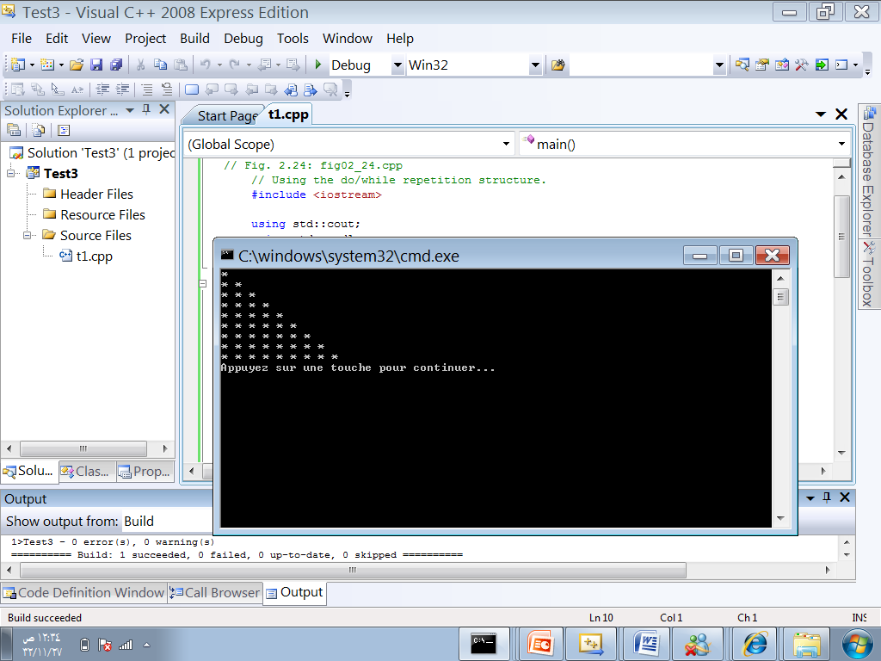
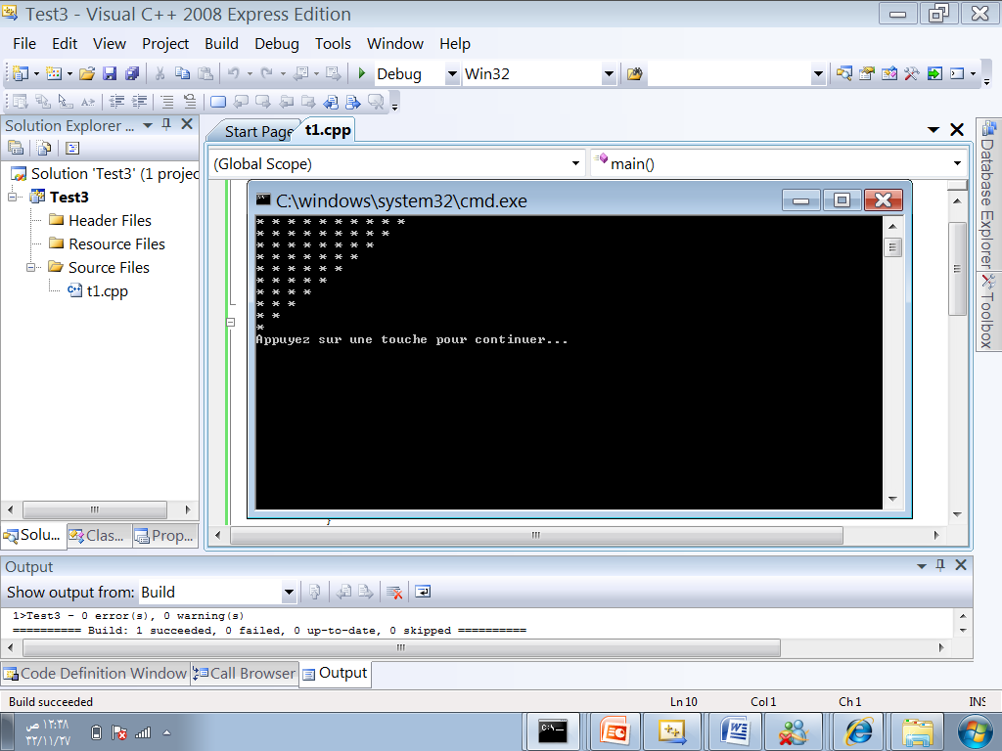
Nesting Loops
Loops can be nested, that is, the loop body can also contain a loop.

Slide 30
Nested Control Structures
Problem statement
  A college has a list of test results (1 = pass, 2 = fail) for 10 students. Write a program that analyzes the results. If more than 8 students pass, print "Raise Tuition".
Notice that
  Program processes 10 results
    Fixed number, use counter-controlled loop
  Two counters can be used
    One counts number that passed
    Another counts number that fail
  Each test result is 1 or 2
    If not 1, assume 2

Slide 31
Nested Control Structures cont..
Top level outline
    Analyze exam results and decide if tuition should be raised
First refinement
    Initialize variables
    Input the ten quiz grades and count passes and failures
    Print a summary of the exam results and decide if tuition should be raised
Refine
      Initialize variables:
        Initialize passes to zero
        Initialize failures to zero
        Initialize student counter to one

Slide 32
Nested Control Structures cont..
Refine
    Input the ten quiz grades and count passes and failures:
      While student counter is less than or equal to ten
      Input the next exam result
      If the student passed
      Add one to passes
      Else
      Add one to failures
      Add one to student counter

Slide 33
Nested Control Structures cont..
Refine
    Print a summary of the exam results and decide if tuition should be raised:
      Print the number of passes
      Print the number of failures
      If more than eight students passed
      Print “Raise tuition”
Program next

Slide 34
Nested Control Structures cont(code)
2 // Analysis of examination results.
3 #include <iostream>
4
5 using std::cout;
6 using std::cin;
7 using std::endl;
8
9 // function main begins program execution
10 int main()
11 {
12 // initialize variables in declarations
13 int passes = 0; // number of passes
14 int failures = 0; // number of failures
15 int studentCounter = 1; // student counter
16 int result; // one exam result
17
18 // process 10 students using counter-controlled loop
19 while ( studentCounter <= 10 ) {
20
21 // prompt user for input and obtain value from user
22 cout << "Enter result (1 = pass, 2 = fail): ";
23 cin >> result;
24

Slide 35
Nested Control Structures cont(code)
25 // if result 1, increment passes; if/else nested in while
26 if ( result == 1 ) // if/else nested in while
27 passes = passes + 1;
28
29 else // if result not 1, increment failures
30 failures = failures + 1;
31
32 // increment studentCounter so loop eventually terminates
33 studentCounter = studentCounter + 1;
34
35 } // end while
36
37 // termination phase; display number of passes and failures
38 cout << "Passed " << passes << endl;
39 cout << "Failed " << failures << endl;
40
41 // if more than eight students passed, print "raise tuition"
42 if ( passes > 8 )
43 cout << "Raise tuition " << endl;
45 return 0; // successful termination
47 } // end function main

Slide 36
Nested Control Structures cont(output)
Enter result (1 = pass, 2 = fail): 1
Enter result (1 = pass, 2 = fail): 2
Enter result (1 = pass, 2 = fail): 2
Enter result (1 = pass, 2 = fail): 1
Enter result (1 = pass, 2 = fail): 1
Enter result (1 = pass, 2 = fail): 1
Enter result (1 = pass, 2 = fail): 2
Enter result (1 = pass, 2 = fail): 1
Enter result (1 = pass, 2 = fail): 1
Enter result (1 = pass, 2 = fail): 2
Passed 6
Failed 4

Slide 37
Nested Control Structures cont(output)
Enter result (1 = pass, 2 = fail): 1
Enter result (1 = pass, 2 = fail): 1
Enter result (1 = pass, 2 = fail): 1
Enter result (1 = pass, 2 = fail): 1
Enter result (1 = pass, 2 = fail): 2
Enter result (1 = pass, 2 = fail): 1
Enter result (1 = pass, 2 = fail): 1
Enter result (1 = pass, 2 = fail): 1
Enter result (1 = pass, 2 = fail): 1
Enter result (1 = pass, 2 = fail): 1
Passed 9
Failed 1
Raise tuition

Slide 38
Break
The break statement exits from a switch or loop immediately.
You can use the break keyword to stop a loop for any reason.

Slide 39
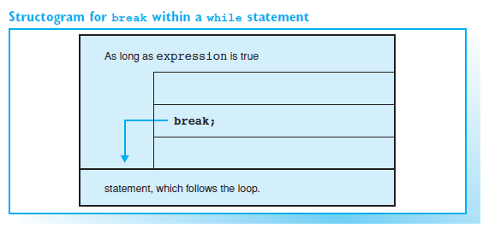
Break cont..

Slide 40
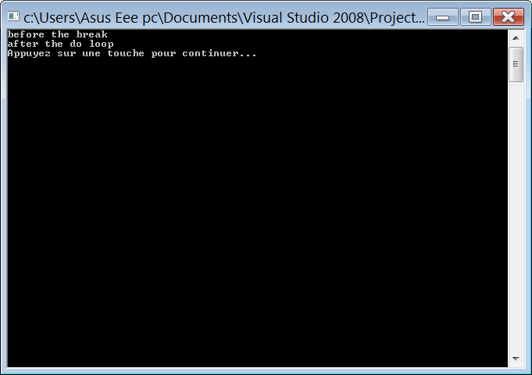
Break cont(example)
#include <iostream>
using namespace std;
int main()
{
int i = 0;
do
{ i++;
cout<<"before the break\n";
break;
cout<< "after the break, should never print\n";
} while (i < 3);
cout<< "after the do loop\n";
system("pause");
return 0;
}
Output :

Slide 41
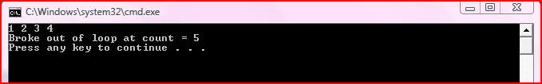
Break cont(example)
#include <iostream>
using namespace std;
int main()
{
int count;
for (count = 1;count<=10;count ++)
{
if (count == 5)
break;
cout<< count<< " ";
}
cout<<"\nBroke out of loop at count = "<<count<<endl;
return 0;
}
Output :

Slide 42
Continue
The continue statement can be used in loops and has the opposite effect to break, that is, the next loop is begun immediately.
In while, do…while:
  The loop continuation condition evaluates immediately after the continue statement executes.
In for statement:
  The increment expression executes, then the loop-continuation test evaluates.

Slide 43
Continue cont(example)..
#include <iostream>
using namespace std;
int main()
{ int i = 0;
do
{ i++;
cout<<"before the continue\n";
continue;
cout<< "after the continue, should never print\n";
} while (i < 3);
cout<< "after the do loop\n";
return 0;
}

Slide 44
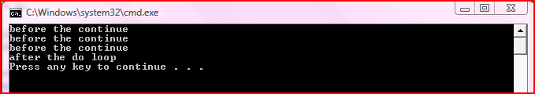
Continue cont(Output)..
Output :

Slide 45
Continue cont(example)..
int main()
{
for (int count = 1;count<=10;count++)
{ if(count == 5)
continue;
cout << count << " ";
}
cout<<"\nUsed continue to skip printing 5"<<endl;
return 0;
}

Slide 46
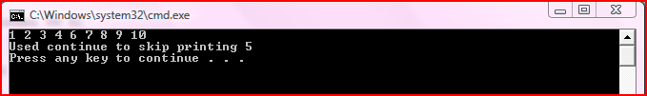
Continue cont(output)..
Output :

