Slide 1
C++ Lab
Flowcharts

Slide 2
Algorithm
An informal definition of an algorithm is:
a step-by-step method for solving a problem or doing a task.
Input data
Algorithm
A step-by-step method for solving a problem or doing a task
Output data

Slide 3
Algorithm
An algorithm is a sequence of unambiguous instruction for solving problem.
The number of steps of an algorithm will be countable and finite.
It is a sequence of instructions to make a program more readable, a process used to answer a question.

Slide 4
How to understand the problem
Define the problem
Analysis the problem
Develop an algorithm/method of solution
Write a computer program corresponding to the algorithm
Test and debug the problem
Document the program( how it works and how to used it)

Slide 5
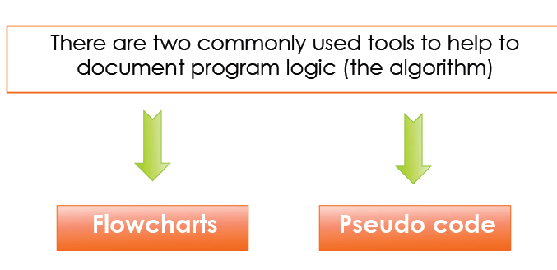
Tools

Slide 6
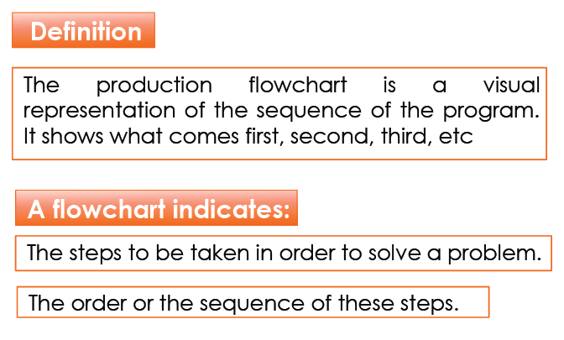
Flowchart

Slide 7
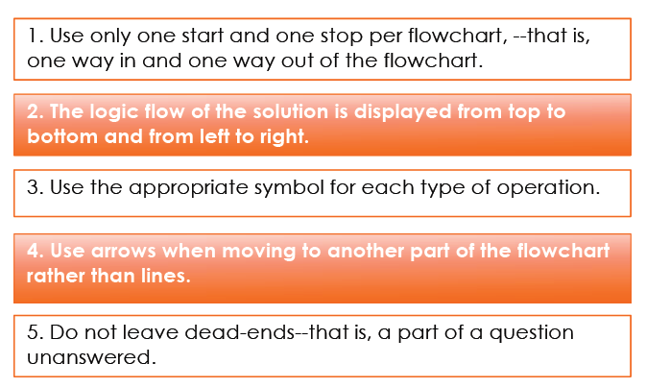
Flowchart Rules

Slide 8
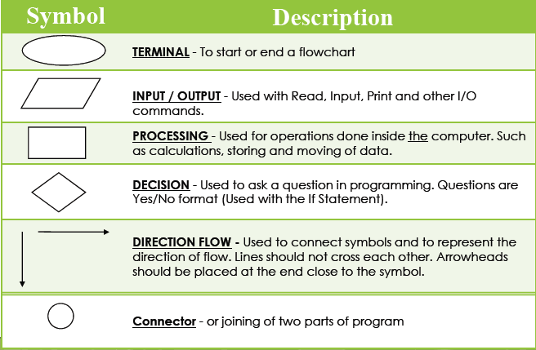
Symbols

Slide 9
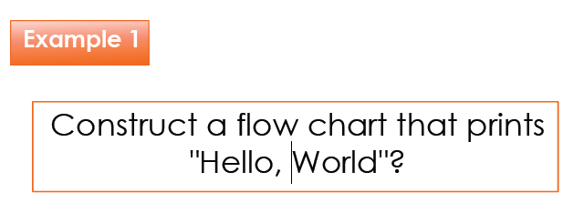
1. Simple Sequential Flowchart

Slide 10
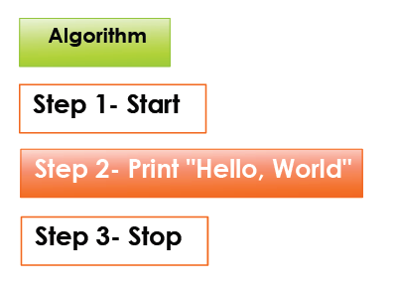
1. Simple Sequential Flowchart

Slide 11
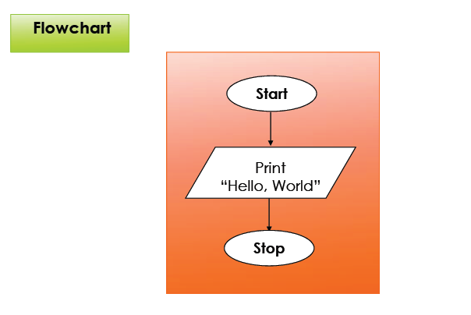
1. Simple Sequential Flowchart

Slide 12
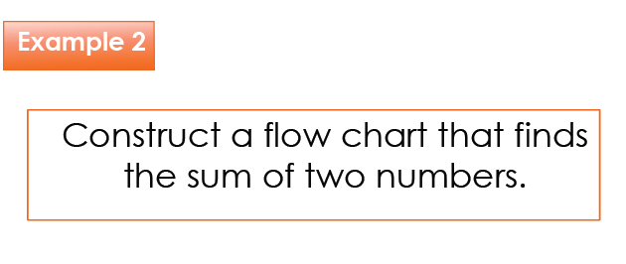

Slide 13
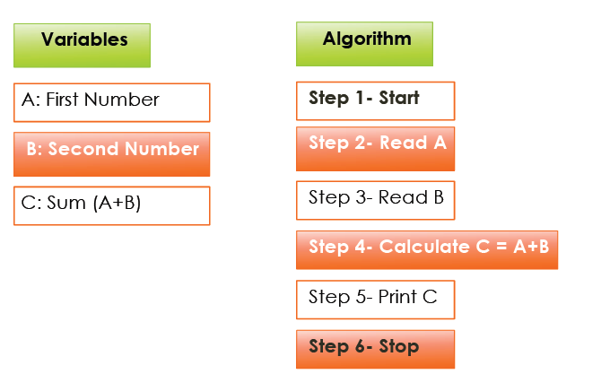

Slide 14
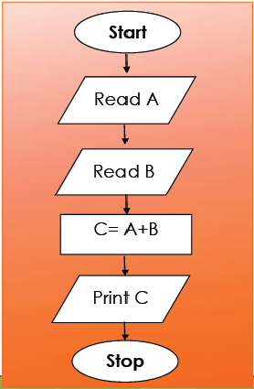

Slide 15
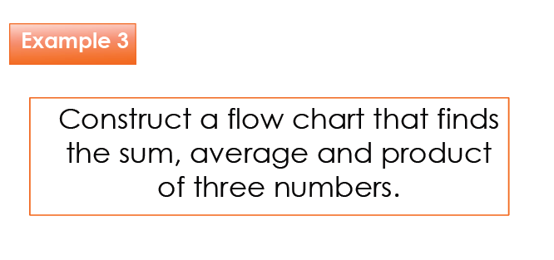

Slide 16
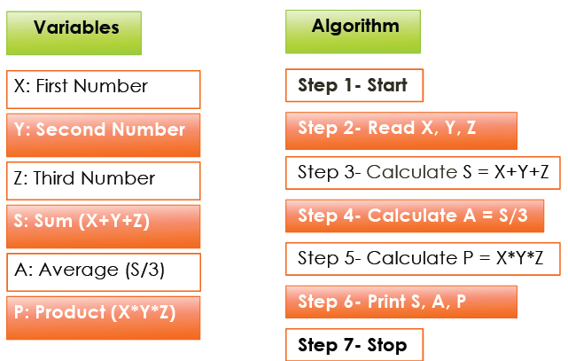

Slide 17
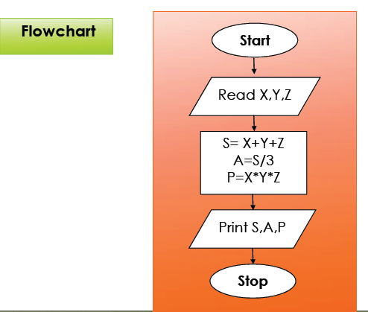

Slide 18
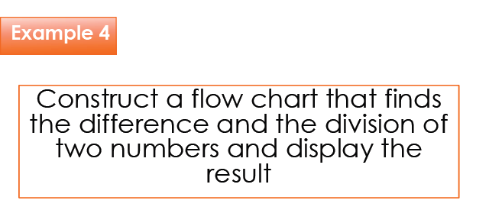

Slide 19
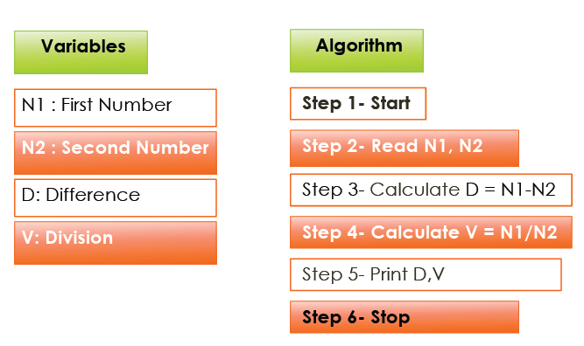

Slide 20
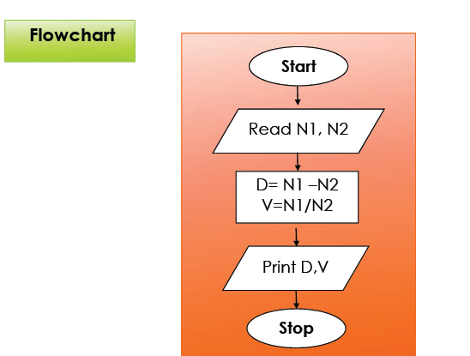

Slide 21
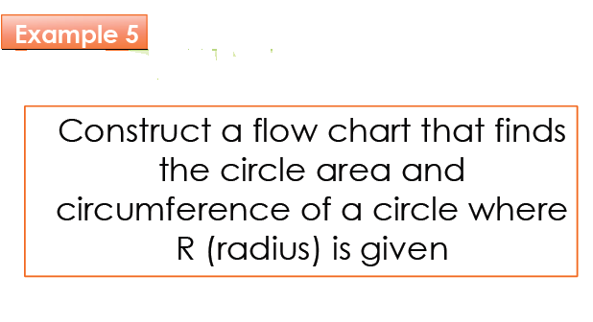

Slide 22
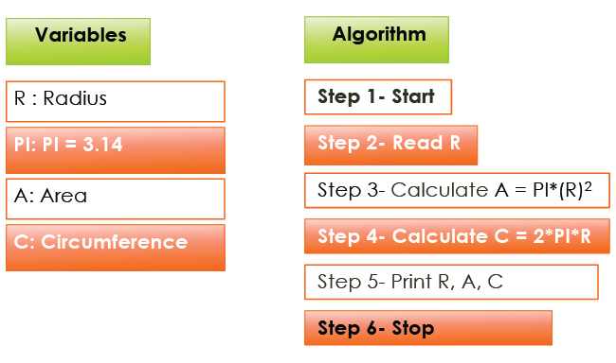

Slide 23
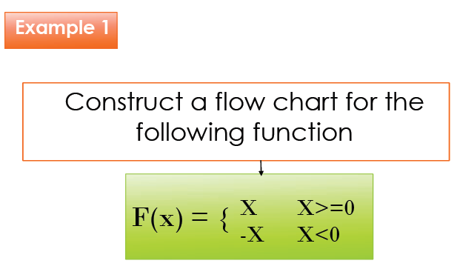
Branched flowchart

Slide 24
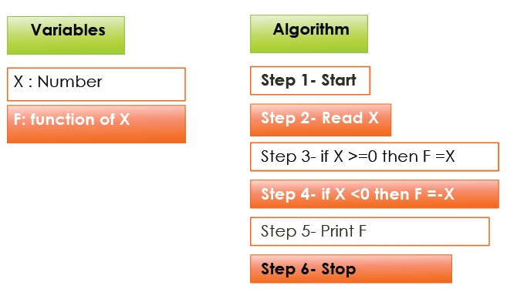

Slide 25
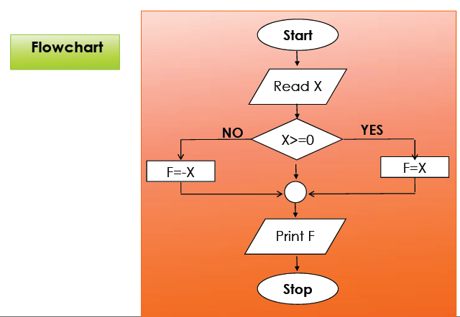

Slide 26
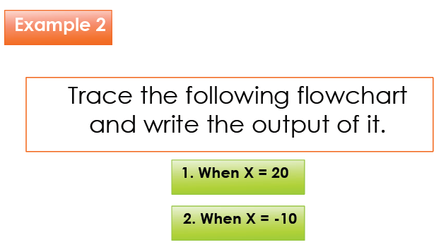

Slide 27
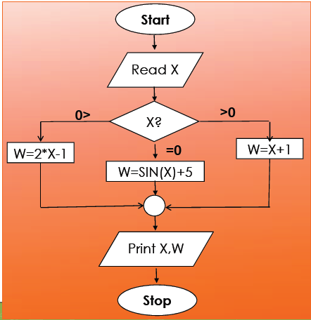

Slide 28
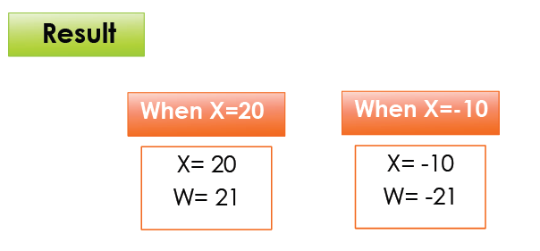

Slide 29
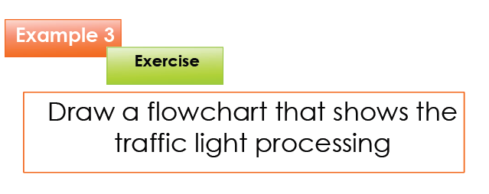

Slide 30
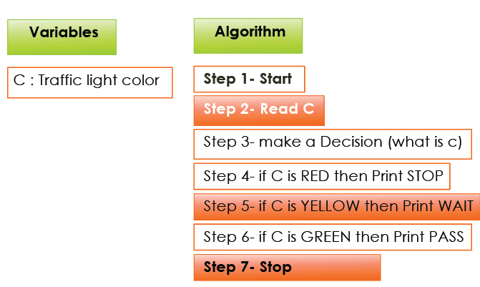

Slide 31
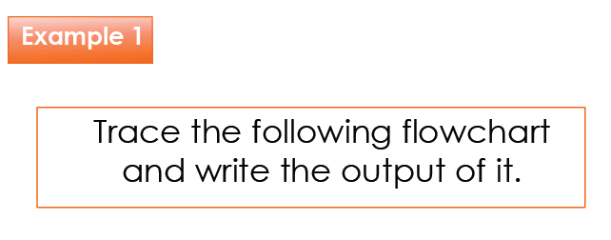

Slide 32
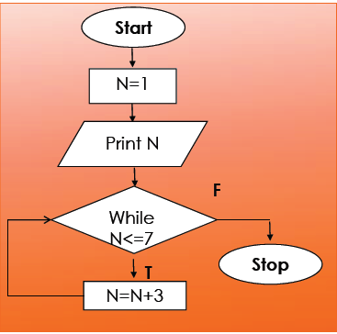

Slide 33
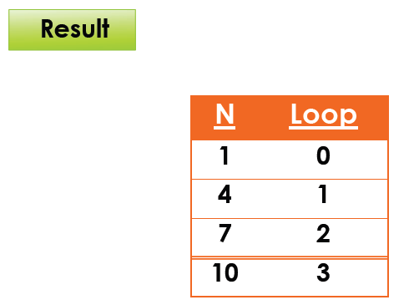

Slide 34
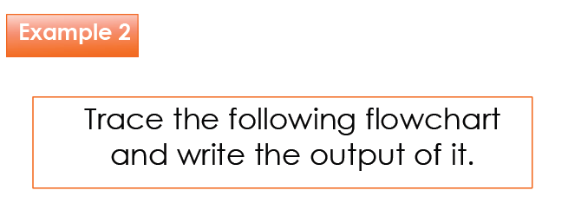

Slide 35
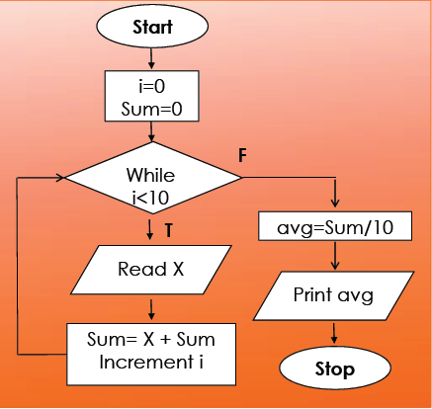

Slide 36
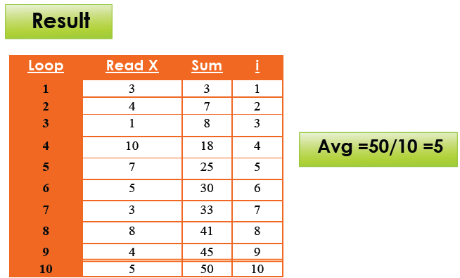
Loop Flowchart

