Slide 1
How to Create your First Program

Slide 2
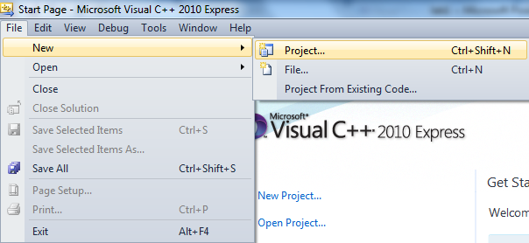
Create a Project

Slide 3
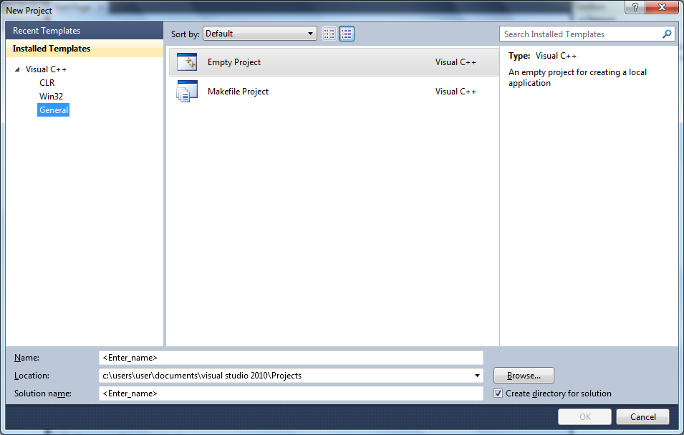
Create a Project
2
1
This is the default location of the project
3
4

Slide 4
Create a Project
C:\Users\user\Documents\Visual Studio 2010\Projects
This Folder differs depending on your user name in your computer.

Slide 5
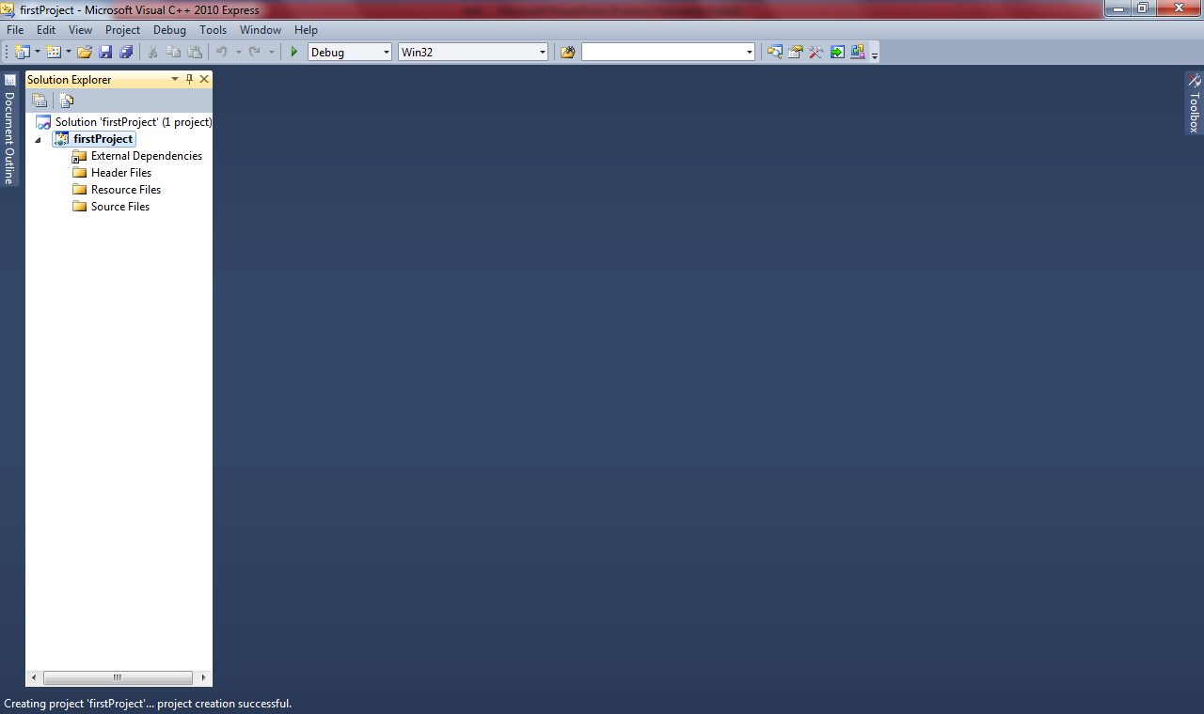
Create a Project
Now, the project is created and shown in the Solution Explorer

Slide 6
Solution Explorer
Solution Explorer
Solution Name = Project Name
Project Name

Slide 7
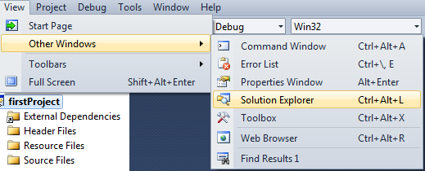
Solution Explorer
If you can not see Solution Explorer, you can show it as the following:

Slide 8
Create a Project
If you want to save your project in a folder on the desktop. How to do it?
Create a folder on the desktop, give it a name:
Yourname
for example: NoraAlAhmad

Slide 9
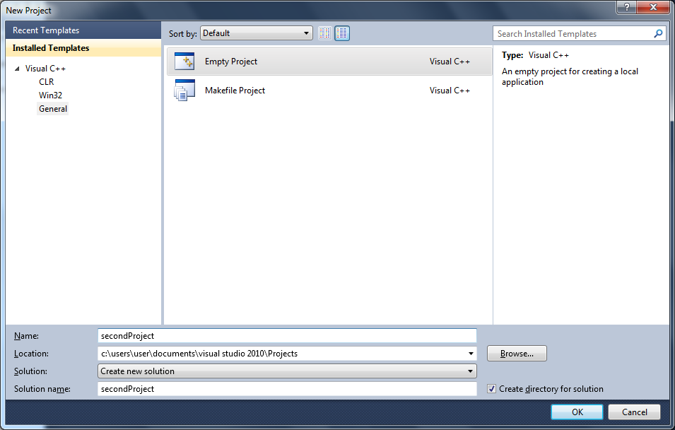
Create a Project
2
1
3
4

Slide 10
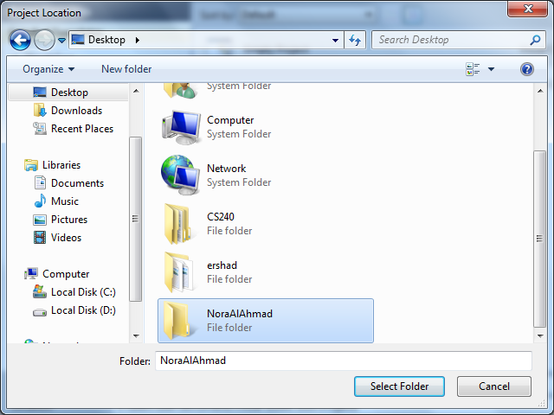
Create a Project
This is the folder name that you want to create the project in it
1
2
3

Slide 11
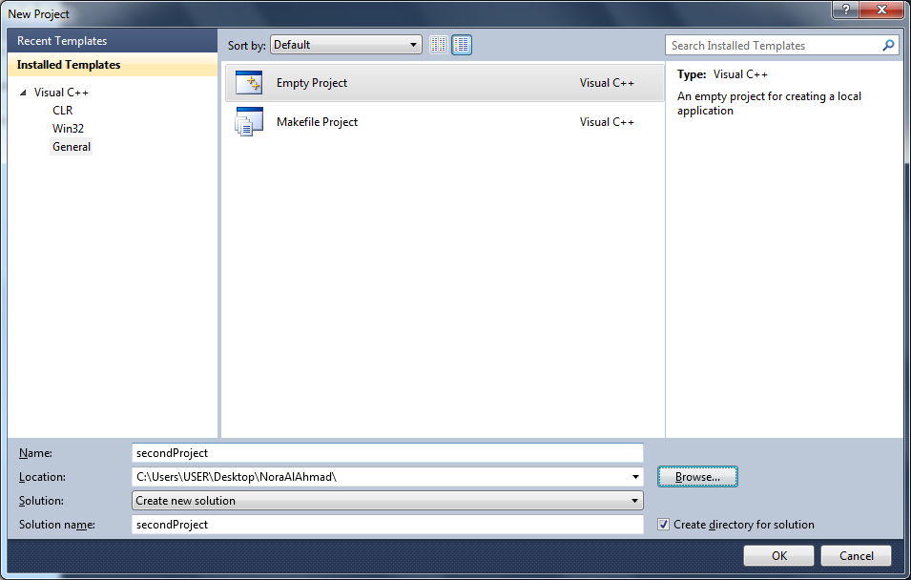
Create a Project
Here, The Project location is a Folder on the desktop.

Slide 12
Adding Source File(.cpp file)
You have to write your program in a file called Source File and its extension is .cpp
So, you have to add a Source File to your project to write your program in it.

Slide 13
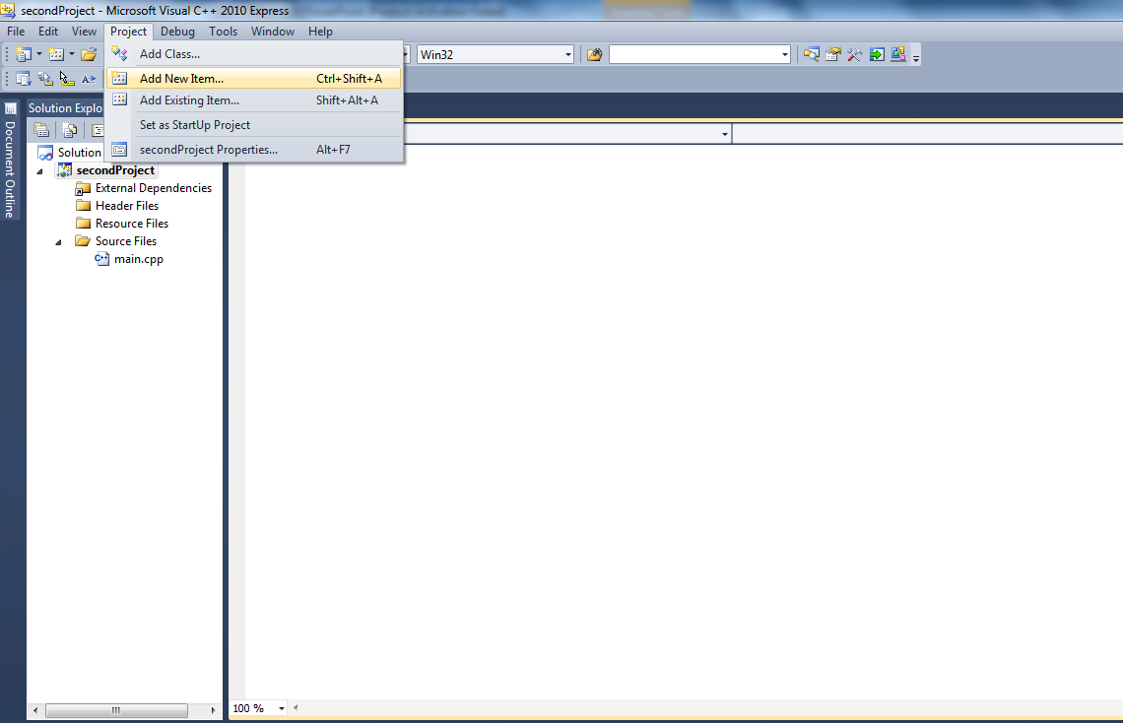
Adding Source File(.cpp file)
2
1.
First of all,
The project should be selected

Slide 14
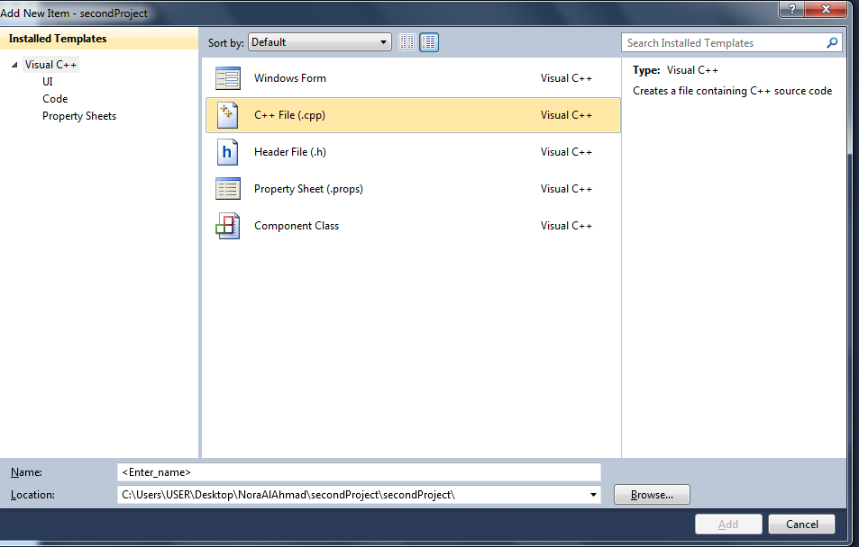
Adding Source File(.cpp file)
1
2
3
4

Slide 15
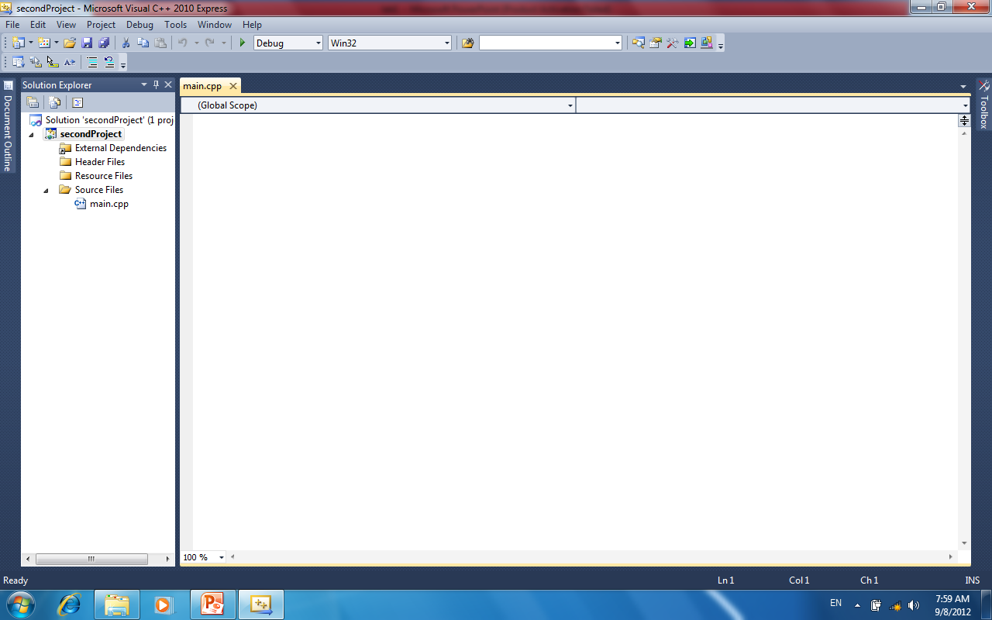
Adding Source File(.cpp file)
Here, you will write your program
.ccp file
Should be under source files folder

Slide 16
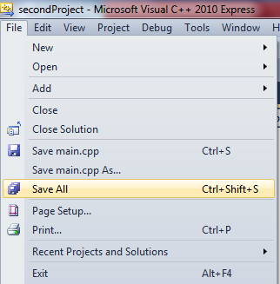
Save your program

Slide 17
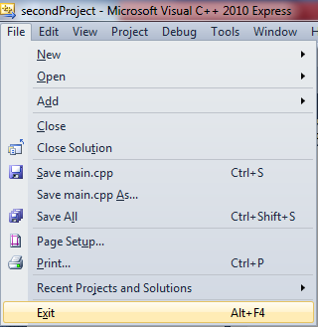
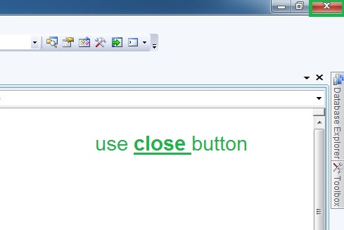
Exit VC++
OR
1.
2.

Slide 18
Open a project
To open a previously created project, there are two ways:
  File ➔ Recent Projects
  used if the project is recently created.
  File ➔ Open ➔ Project/Solution

Slide 19
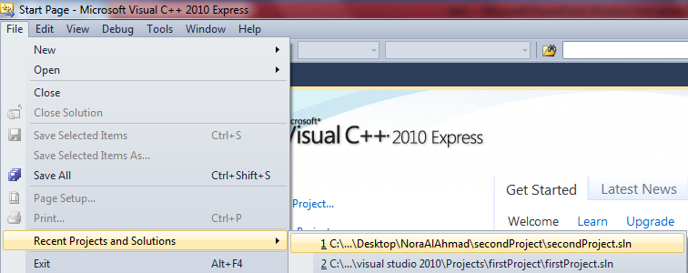
Open a project
File ➔ Recent Projects
Then, choose the project.

Slide 20
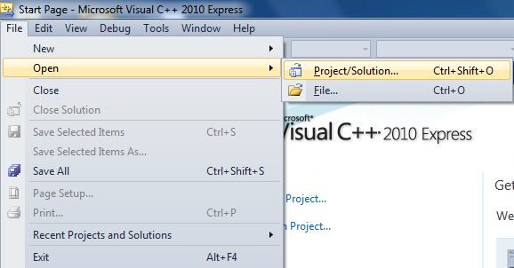
Open a project
  File ➔ Open ➔ Project/Solution
  Then, Browse for the project file.

Slide 21
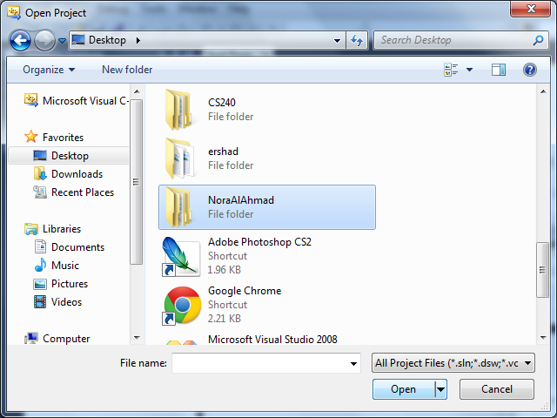
Open a project
1
2
3

Slide 22
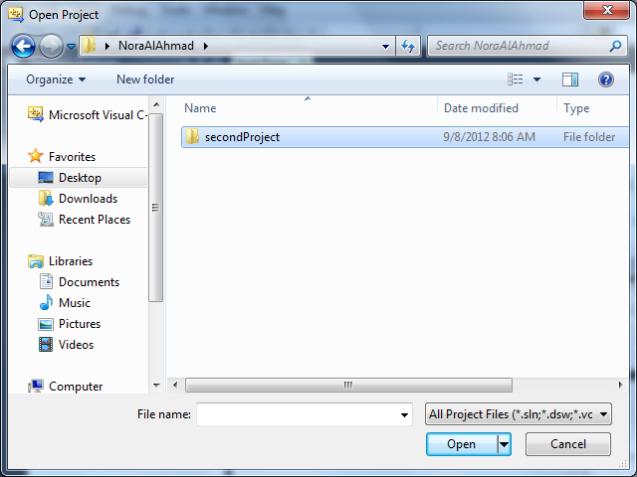
Open a project
1
2

Slide 23
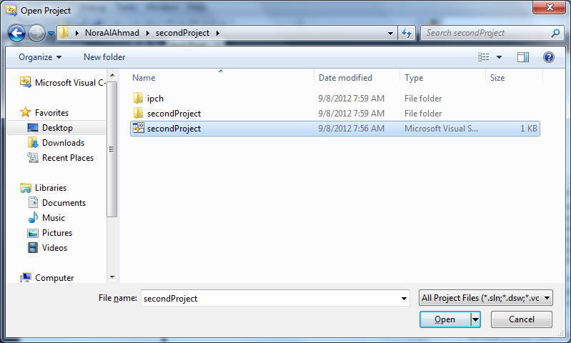
Open a project
1
2

Slide 24
How to print your code

Slide 25
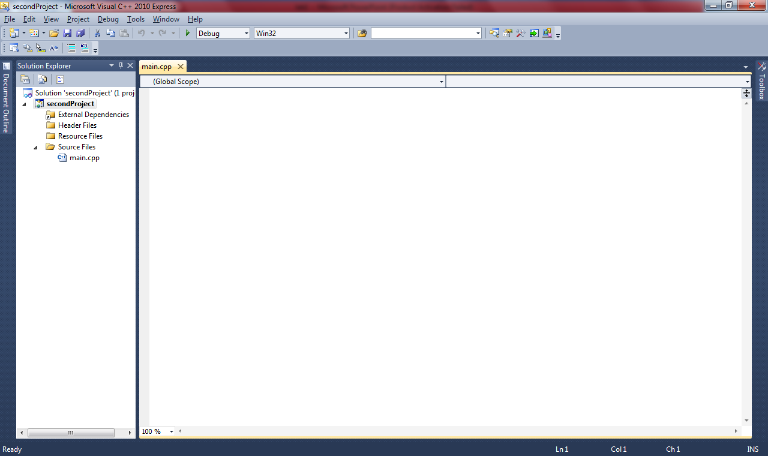
Make sure that the cursor is located HERE

Slide 26
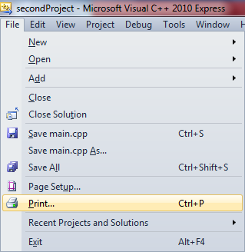

Slide 27
How to locate the source file(.cpp)

Slide 28

Project Name
This the file that contains your code. This is what you should send to me.

Slide 29
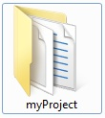

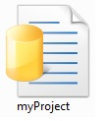
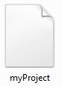
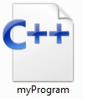
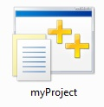
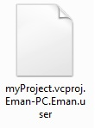
Locate the .cpp file
The Project folder
= Project Name
This the file that contains your code. This is what you should send to me.

